Slide 1
RFP & Scope of Services
Reducing Administrative Burden

Slide 2
RFP
1. STATEMENT OF NEED.
a. What problems or needs will this program address? State needs in numerical terms and/or as compared with other areas or as a sub-population that has a disproportionate level of need than the general population.

Slide 3
Proposal
Need Statement:
This application addresses three primary needs:
There is a need to augment the income of economically disadvantaged senior citizens in East Providence, where 7% of seniors have an income of less than $10,000 and 35% less than $20,000. The average annual Social Security benefit for an East Providence senior is $15,507 (seniorcare.com/directory/RI), and 31% of residents age 60 years or older received food stamps in the past year. EBCAP's Foster Grandparent Program provides stipend volunteer opportunities for individuals aged 55 and over.

Slide 4
Scope of Services
I. Program Design
Need Statement:
There are three primary needs:
There is a need to augment the income of economically disadvantaged senior citizens in East Providence, where 7% of seniors have an income of less than $10,000 and 35% less than $20,000. The average annual Social Security benefit for an East Providence senior is $15,507 (seniorcare.com/directory/ri), and 31% of residents age 60 years or older received food stamps in the past year. EBCAP's Foster Grandparent Program provides stipend volunteer opportunities for individuals aged 55 and over.

Slide 5
Performance Based Measures Saves Time to Review Requests for Reimbursements

Slide 6
Once you have checked the Cost Reasonableness of an activity, you can base requests for reimbursements on a per beneficiary basis instead of the sub grantee submitting copies of invoices, payroll, and other documentation of expenditures. This requires that each invoice being submitted to be accompanied by a Report that details the # of beneficiaries and service provided.

Slide 7
Part of the RFP
Outputs:
The East Bay Foster Grandparent Program will provide at least 30 East Providence low-income seniors with approximately $75,000 in stipend payment for 25,000 hours of service to 725 children needing additional assistance. Volunteers will serve children in 12 sites, including public schools, libraries, and Head Start programs throughout East Providence. If Foster Grandparents cannot return to in-person learning due to the pandemic, volunteers will assist as many children as possible remotely. The number of hours served and the stipends paid will be recorded and compiled by program staff every two weeks. In addition, semiannual reports will be completed reporting the number of organizations served and the number of children benefitting from the program.

Slide 8
Part of Scope of Services
All reimbursement requests must be equal to or under the following performance based payment system or written explanation is required with invoice:
The Contractor shall be reimbursed for services performed according to the measure below but not to exceed $8,000:
$300/per documented low to moderate income senior participating in the Foster Grandparent Program.

Slide 9
Calculate to Fully Expend Agreement $$ if Proposed Accomplishments Are Not Completely Met
$8,000 / 30 = $266 per Senior Participating in Program
$8,000 / $300 = 26

Slide 10
Evaluation Criteria
The RFP has a corresponding evaluation criteria that allocates points for each question.

Slide 11
2. ADDRESSING THE NEED Up to 20 Points 15 Points
5 points - If specific data or documentation is provided from a reliable source or study that supports the stated results of the activity: Score = 3
Proposal provides the results they hope to obtain but there is no data that is used in this section to support the results. (There is a lot of data in the previous section though, which could constitute as support)
5 points - If specific data or documentation is provided from a reliable source or study that supports the activity's approach: Score = 3
Proposal provides the approach that they will take but does not provide data that supports this. (There is a lot of data in the previous section though, which could constitute as support)

Slide 12
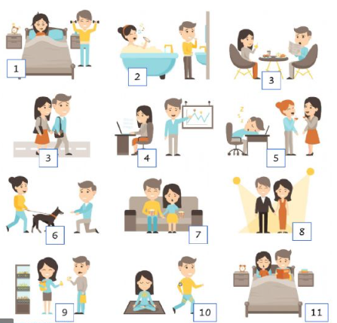
Monitoring Subrecipients A Day In the Life

Slide 13
Ask for the submission of an example of one day of a beneficiary that includes everything from outreach to intake, pre-and post-evaluations, income eligibility documentation, documented provision of services, documented cost of services provided, etc.

Slide 14
HUD Monitoring
This makes it easier for HUD staff when they are monitoring you. You still need to do additional things for monitoring subrecipients but having this file in your offices may prevent HUD from visiting the subrecipients’ offices.

